Slide 1
U Code Bro?
Devon Hackathon 2017

Slide 2
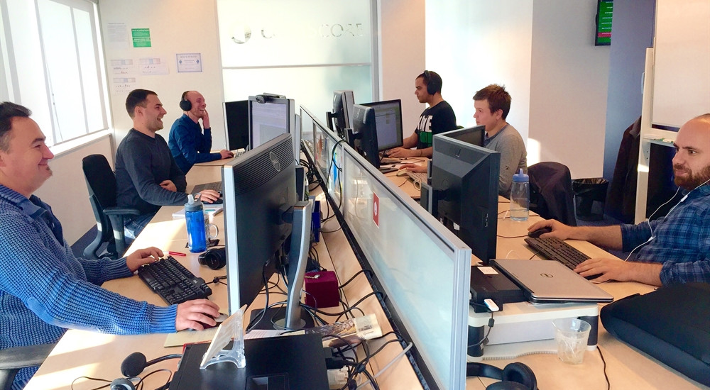
U Code Bro?
Chris Masters
Staff Software Engineer
Jamie Dulaney
Staff Software Engineer
Jennifer Bono
Sr Technical Product Manager
Roary Tubbs
Sr UX Interaction Designer
Christy Taylor
Manager – Software Engineering

Slide 3
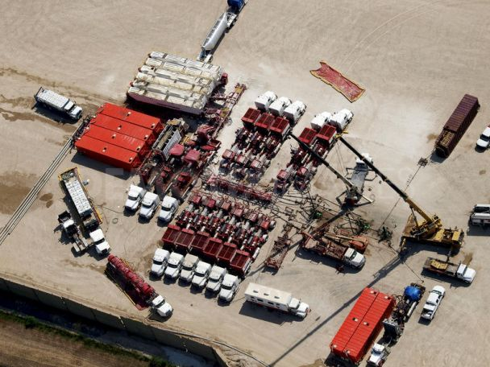
U Code Bro?
Significant cost increases caused by screen-outs
PIC on-site utilization inefficient
Decision errors/delays from inexperience
Actions delayed due to manual processes
Problem Statement - Completions

Slide 4
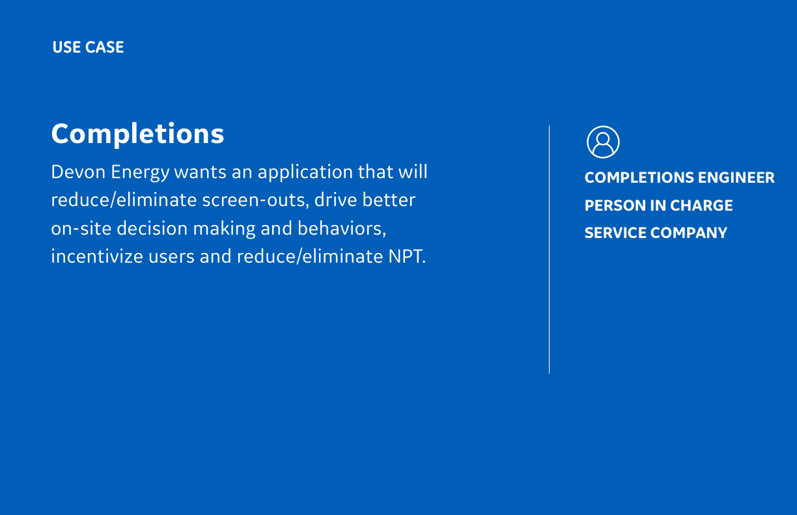
U Code Bro?

Slide 5

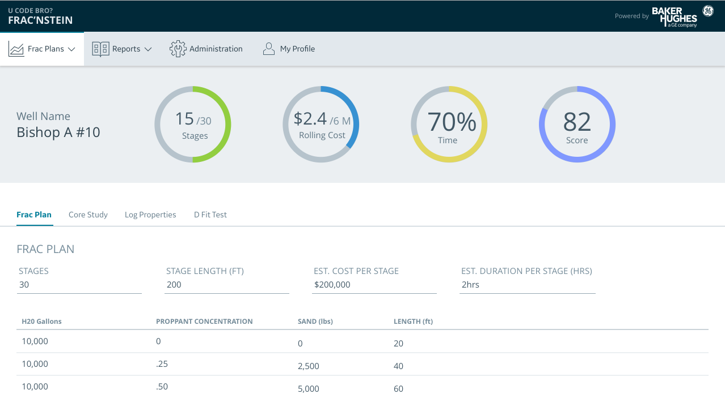
U Code Bro?
Solution – Frac’nstein
Predict screen-outs and automate corrective action
Advisories for frac stage bypass
Incentivize users based on scorecard
Reduce NPT -> Save $$

Slide 6
U Code Bro?
Assumptions
100% Connectivity at Pad Site
Persona focus:
Completions Engineer
PIC
3rd Party Frac Crew

Slide 7
Frac Plan

Slide 8
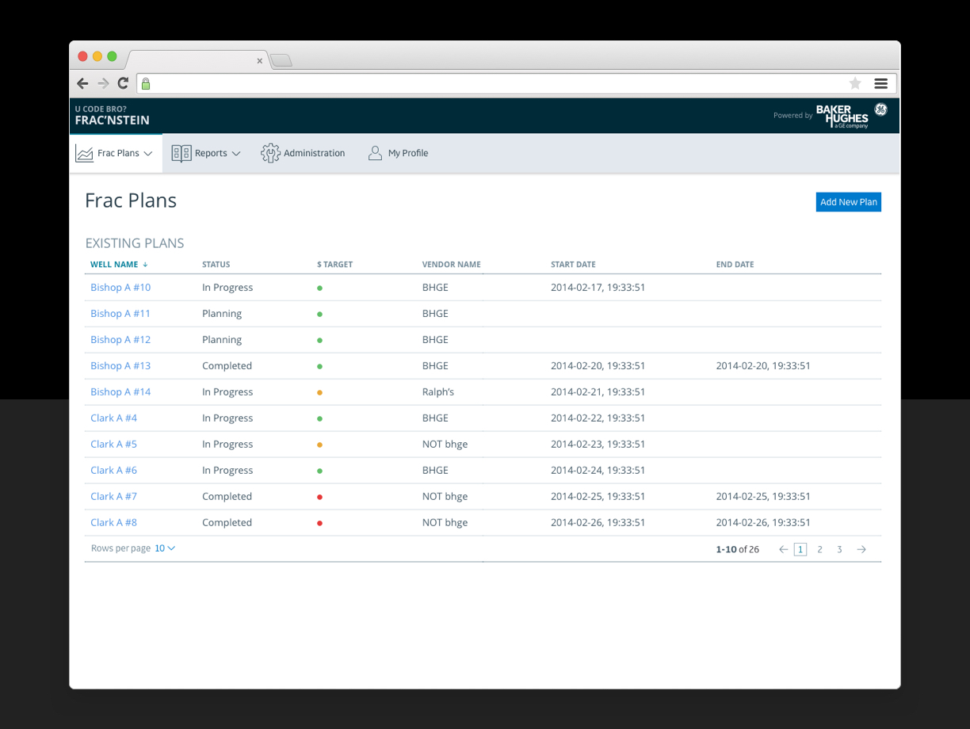

Slide 9
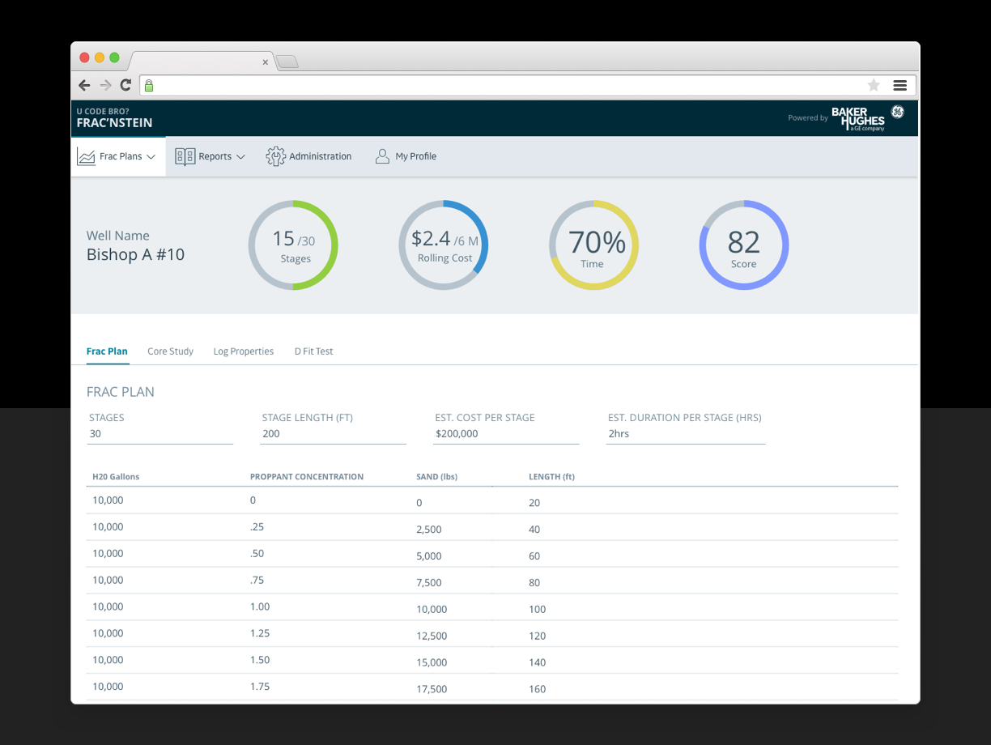

Slide 10
Screen-Out Prediction

Slide 11
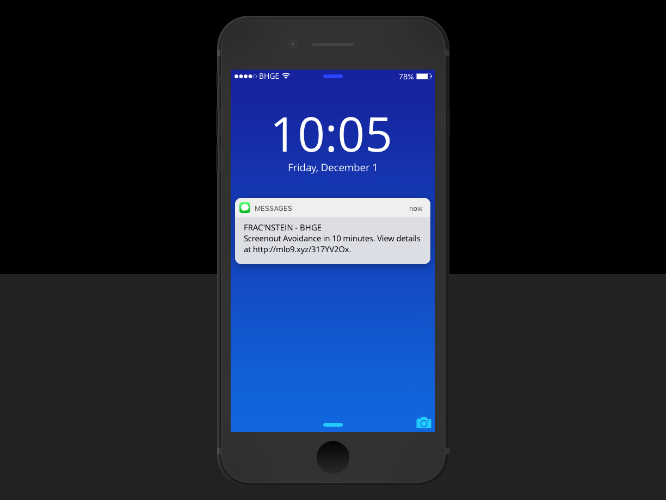
Text notification sent to:
PIC
Frac Crew
Automated corrective action

Slide 12
Stage Bypass Advisory
Preview the mobile app on your phone:
Go to: Theory.cafe
Tap on Dashboard

Slide 13
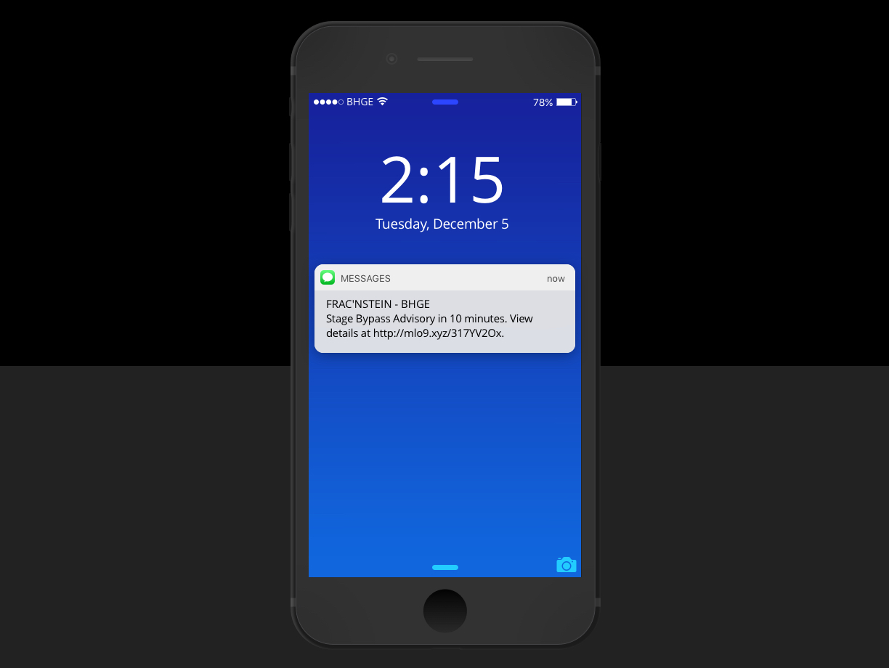
Text notification sent to:
Completions Engineer
PIC
Frac Crew
To view on mobile device:
Go to : Theory.cafe
Tap: Dashboard

Slide 14
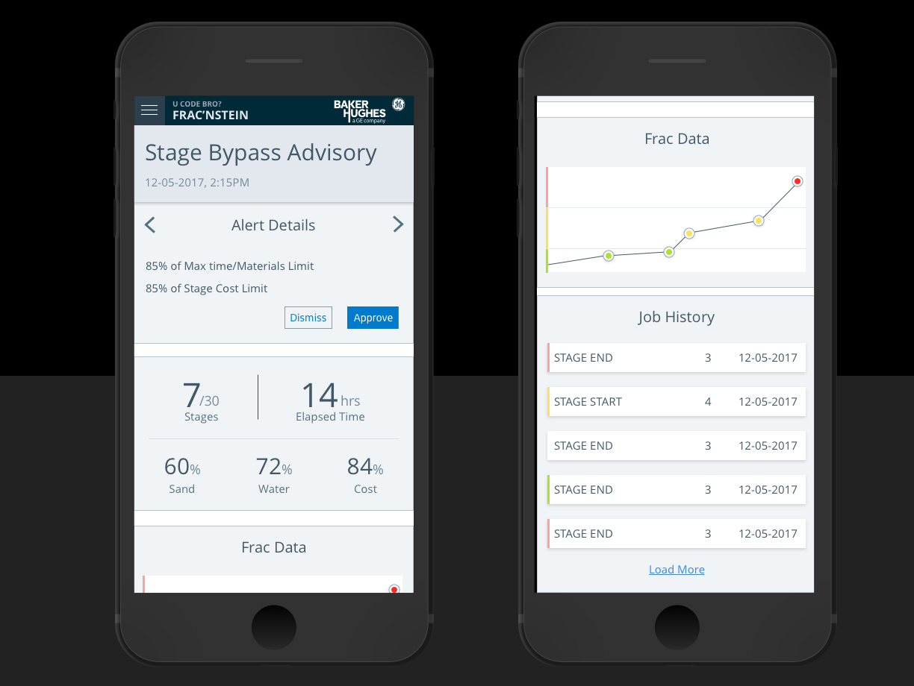

Slide 15
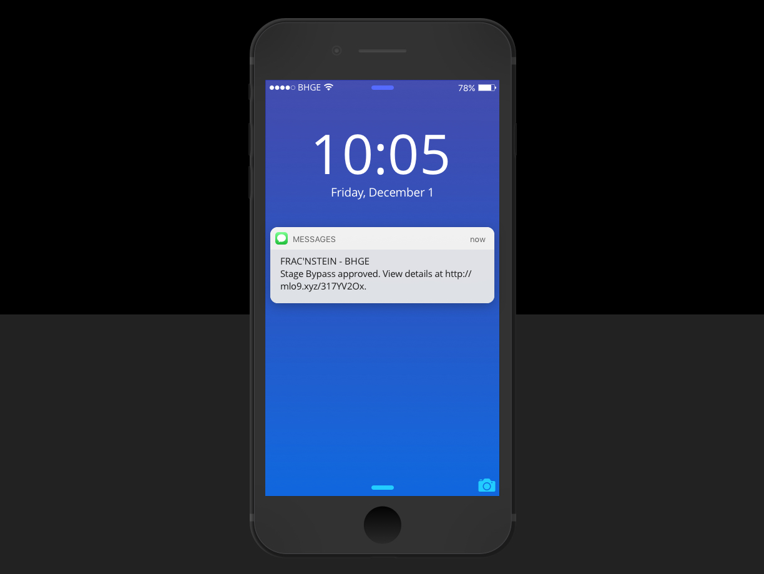
Text notification sent to:
PIC
Frac Crew
To view on mobile device:
Go to : Theory.cafe
Tap: Dashboard

Slide 16
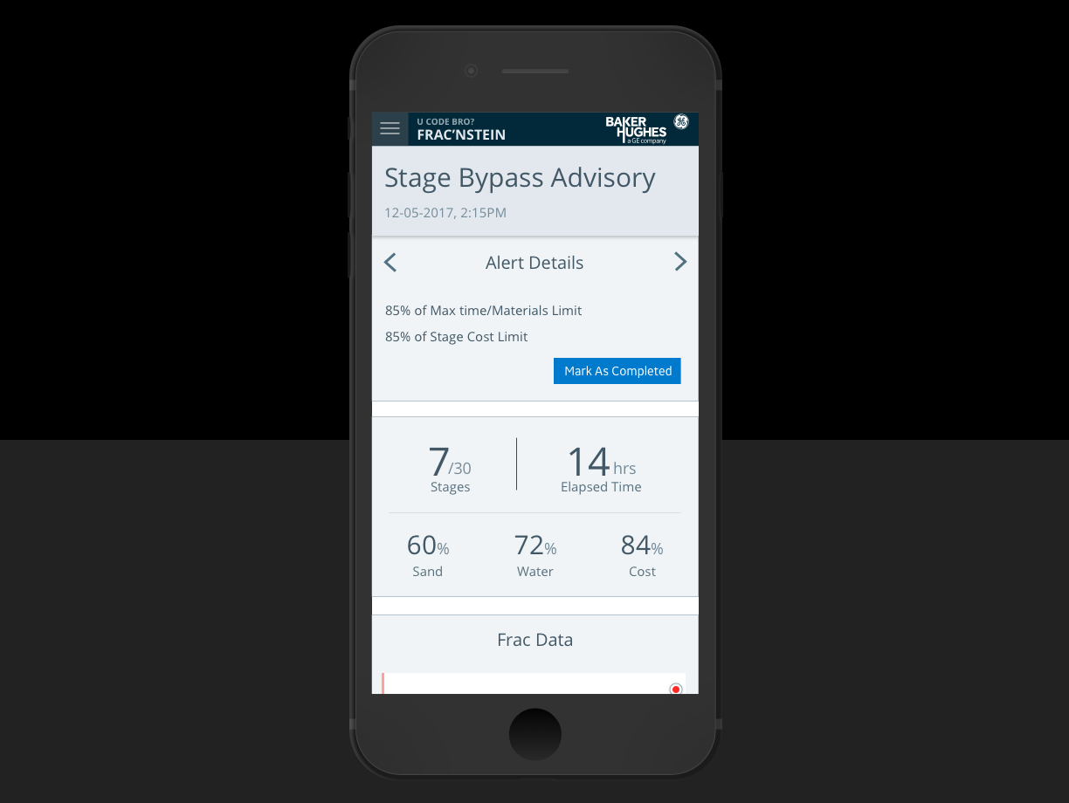
Text notification sent to:
PIC
Frac Crew
To view on mobile device:
Go to : Theory.cafe
Tap: Dashboard

Slide 17
Shutdown

Slide 18
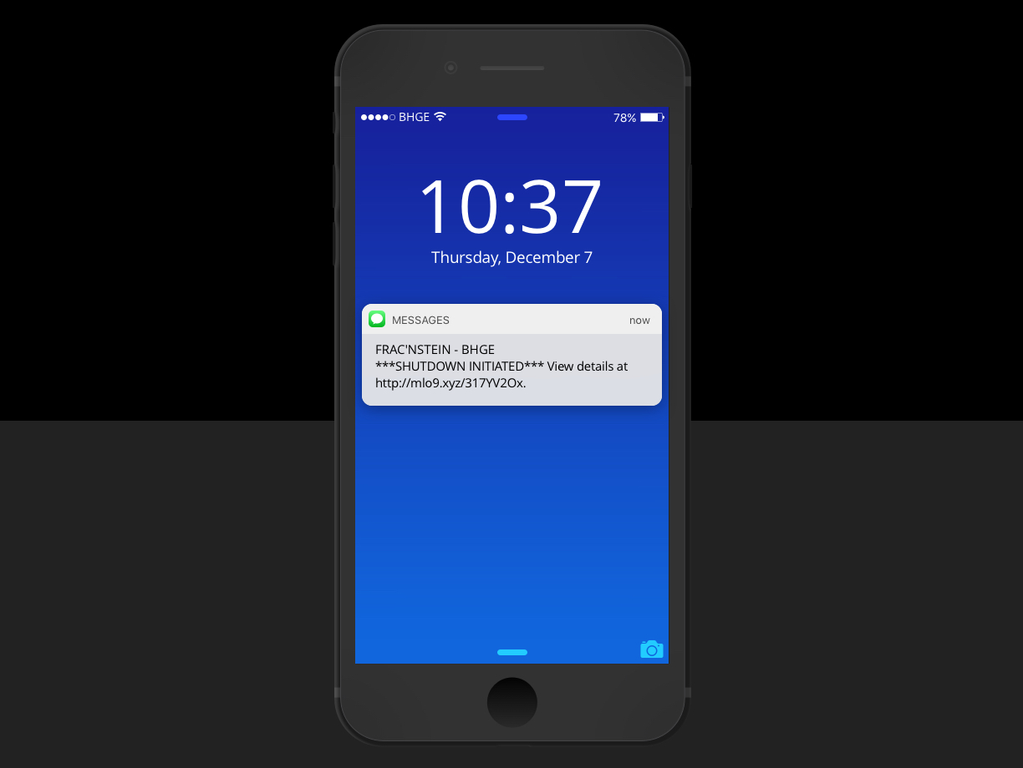
Text notification sent to:
Completions Engineer
PIC
Frac Crew
To view on mobile device:
Go to : Theory.cafe
Tap: Dashboard

Slide 19
Frac Complete

Slide 20
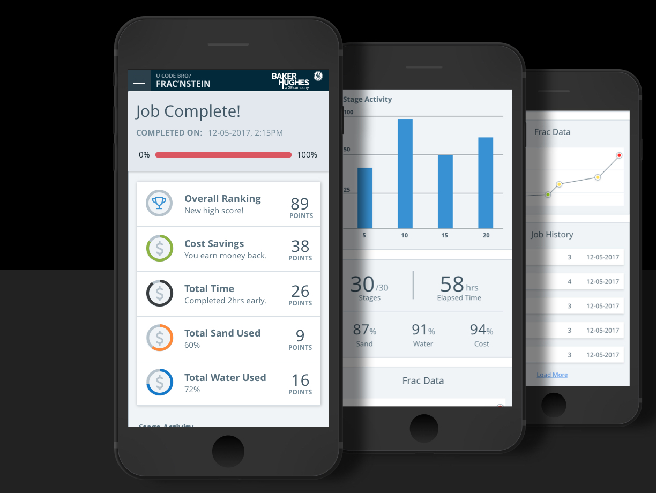

Slide 21
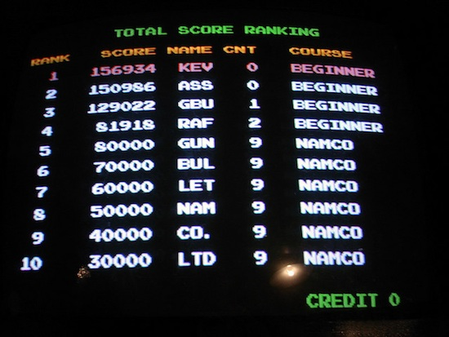
U Code Bro?
Future Considerations
PIC Hall of Fame
Incentivized advisories
Cost variance between stages
Pump optimization

Slide 22
Thank you!

